Slide 1
W3C VCWG TF Vocabularies for DPP
Carolynn Bernier, CEA
August 31, 2026

Slide 2
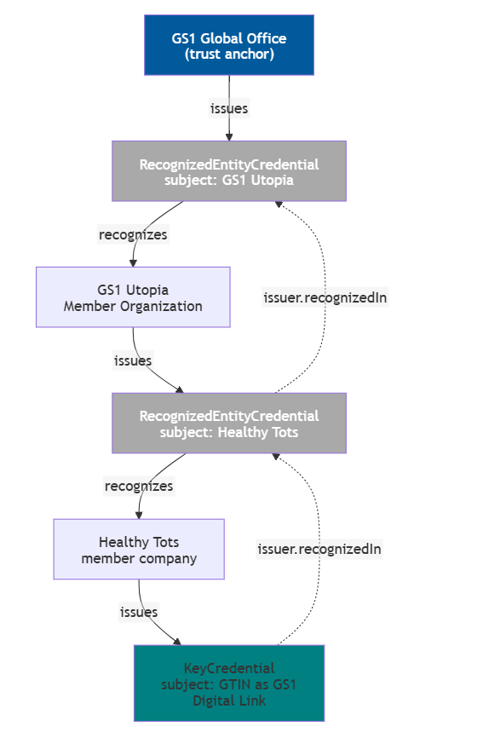
Updates August 24 meeting
ecosystem example in Recognized Entities Rec. Annex B
Confusion around the term “Verifiers” :
Relying party (the person or organisation) checking the validity of the credential.
The software performing the verification.
Recognized entities credential : They can be issued to gather trust information about either issuers or verifiers. This is done using the RecognizedAction which can be either issue or verify. https://w3c.github.io/vc-recognized-entities/#recognizedaction
Decision to add an ecosystem example in Recognized Entities Rec. Annex B for a DPP including verified CE marking credential : Who is the trust anchor ? EC GROW trusted list https://webgate.ec.europa.eu/single-market-compliance-space/notified-bodies/notified-body-list?filter=notificationStatusId:1,legislationId:162960
Note that there can be many trust anchors, not only one !! E.g. an international body of all notified bodies.
CABs must be notified by the Member State authorities (the notifying authority) to the Commission. Notifying authorities are involved in the assessment, notification and monitoring of conformity assessment bodies that have been notified to the Commission, thereby becoming notified bodies. These exchange information on notified bodies with national authorities, the notifying authorities of other Member States and the Commission.
BattReg : Conformity of sustainability, performance, safety, labelling and information requirements. It talks of a “conformity certificate”
EU declaration of conformity (Article 18)
https://gs1.github.io/GS1DigitalLicenses/#gtin-key-credential

Slide 3
Updates August 24 meeting
For the EU Batteries Regulation (EU) 2023/1542, there is a specific legal route to becoming a Notified Body, and the list in your link is the Commission's list for this legislation. EU Commission — Notified Body list for the Batteries Regulation
The key provisions are Articles 21–30 and Annex VIII of Regulation (EU) 2023/1542. (EUR-Lex)
1. You apply to the notifying authority in the EU Member State where your conformity-assessment body is established.
Article 28(1) expressly says:
the conformity assessment body submits its application to the notifying authority of the Member State in which it is established. (EUR-Lex)
The Member State has responsibility for assessing and notifying the organisation.
2. The notifying authority submits the notification to the Commission
Once the national authority is satisfied it submits the notification electronically to the European Commission and the other Member States.
3. The Commission gives you your Notified Body number
Once the notification is effective, the Commission assigns an identification number. Then the Commission adds the new notified body to the public list of bodies notified under the Batteries Regulation here: EU Commission — Notified Body list for the Batteries Regulation
including: the identification number; the conformity-assessment activities for which the body is notified.
The Declaration of Conformity itself is issued under the sole responsibility of the economic actor (see https://eur-lex.europa.eu/eli/reg/2023/1542/oj/eng#anx_IX (3) ) The Notified Body merely issues the Conformity Certificates (e.g. EU Type Examination Certificate) or Approval Decisions (e.g. Quality System Approval) that are referenced in the Declaration of Conformity.

Slide 4

www.tic-council.org/ TIC Council currently represents over 100 international third-party testing, inspection, certification and verification organisations around the world.
Proposed ecosystem example (Recognized Entities Rec.)
European Commission
(hypothetical trust anchor)
TIC Council
(hypothetical additional trust anchor)
issues
Type : RecognizedEntityCredential
Subject: CountryA notifying authority
issues
recognizes
issuer:recognizedIn
Type : RecognizedEntityCredential
Subject: Registered CAB
Member state notifying authority
(hypothetical trust anchor)
issues
Type : RecognizedEntityCredential
Subject: Accredited CAB
recognizes
The EU Declaration of Conformity identifies battery model/item
recognizes
issuer:recognizedIn
Conformity Assessment Body (i.e. the notified body, e.g. TüV)
issuer:re-
cognizedIn
issues
issues
Type : untp:DigitalConformityCredential
Subject: EU Declaration of Conformity
Battery Manufacturer
Type : untp:DigitalConformityCredential
Subject: EU Conformity Certificate
or
issues
is about
EU Declaration of Conformity
references a
(optional)
Type : EU DPP
Subject: Battery #123
references a
references a
references
Results of test reports proving compliance

Slide 5
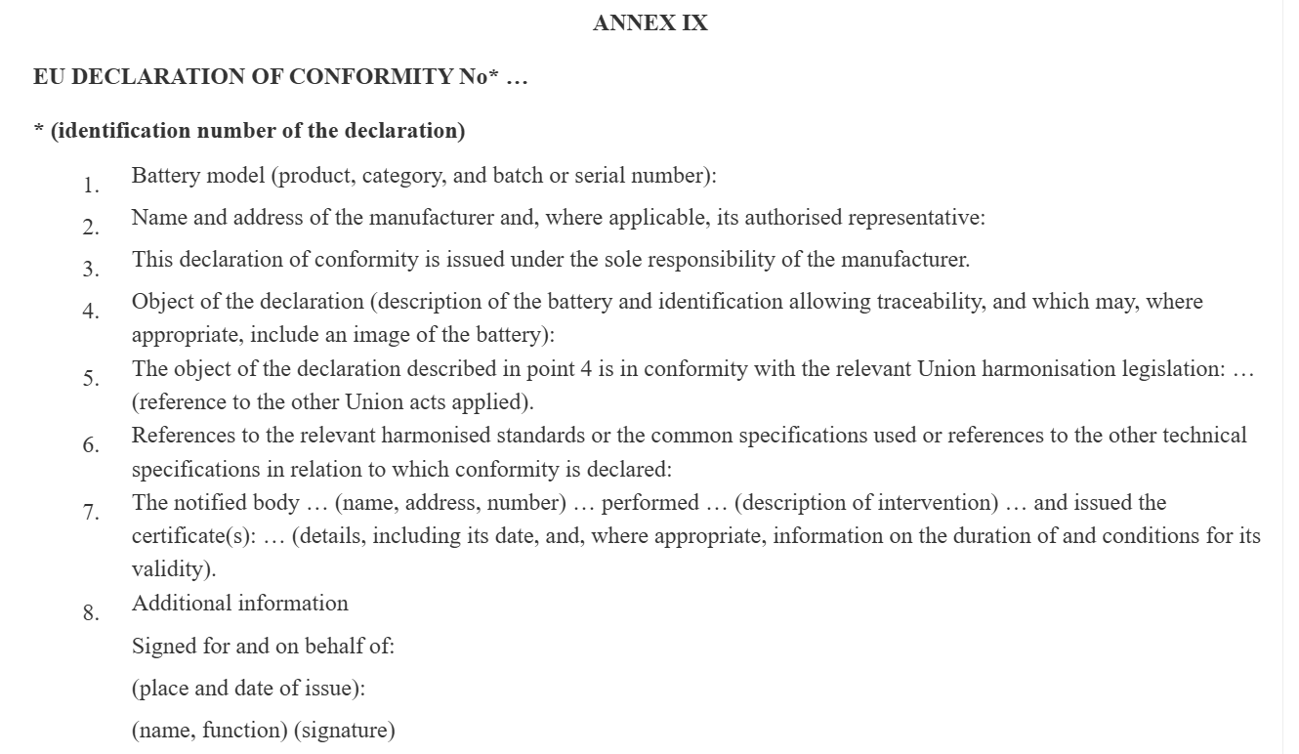
EU Declaration of Conformity (From Battery Regulation)

